Slide 1


Department of Technical Education
GOVERNMENT ENGINEERING COLLEGE
RAMANAGARA -562159
PROJECT WORK PHASE-2
Seminar on
“ Face Mask Detection System Using Deep Learning Techniques ”
BY,
ABHISHEK MR 1GG19CS400
HARSHITHA TS 1GG18CS021
SAGAR N C 1GG19CS407
SANIYA BANU R 1GG19CS408
Under the guidance of,
Mrs.KOMALA K V
Asst professor,
Dept of CSE
GEC, Ramanagara.

Slide 2
CONTENTS
Introduction
Objectives
Literature survey
System design
Framework used
Architecture Diagram
Training model diagram
Hardware and software requirements

Slide 3
INTRODUCTION
In order to protect ourselves from the COVID-19 Pandemic, almost every one of us tend to wear a face mask.
It becomes increasingly necessary to check if the people in the crowd wear face masks in most public gatherings such as Malls, Theatres, Parks.
The development of an solution to detect if the person is wearing a face mask and allow their entry would be of great help to the society.
This model can also be used to develop a full-fledged software to scan every person before they can enter the public gathering.

Slide 4
OBJECTIVES
The Objectives of our project are:
Recognise the individual on picture/vedio transfer wearing a face mask with the assistance of PC vision and profound learning calculation by utilizing the python library.
It ensures a lightweight representation that makes real-world masked face recognition a feasible task.Moreover masked regions vary from face to face to another,which leads to informative images from different sizes.
It has to display the percentage of how much accurately the person wear a mask .

Slide 5
Literature survey
Title | Covid-19 Face Mask Detection Using TensorFlow, Keras and OpenCV [2020]
Author | Arjya Das, Mohammad Wasif Ansari, Rohini Basak
Methodology | This paper presents a simpliﬁed approach to serve the above purpose using the basic Machine Learning (ML) packages such as TensorFlow, Keras, OpenCV and python libraries.
Result | In color images, sometimes skin color can be used to find faces; however, this may not work with all complexions.
Advantages | Representation capacity is more
Disadvantages | More computationally intensive. And more training needed.

Slide 6
Title | Face Mask Detection using Convolutional Neural Network (CNN) to reduce the spread of Covid-19 [2020]
Author | Prof. Dr. ChristophLippert, Benjamin Bergner, RazaAli, SaniyaAdee ,Akhyar Ahmed , MdHasanShahriar, MdShohelMojumder
Methodology | The basic aim of their project was to detect the presence of a face mask on human faces on live streaming video as well as on images. They have used deep learning to develop their face detector model.
Result | We used two datasets to detect masks from images: 1845 images from various sources and 120 co-author's photos taken with a webcam and a mobile phone camera.
Advantages | Easy to integrate. Face detection and facial recognition technology is easy to integrate, and most solutions are compatible with the majority of security software.
Disadvantages | Massive data storage burden. The ML technology used in face detection requires powerful data storage that may not be available to all users.

Slide 7
Title | Detection of Face Mask using Convolutional Neural Network [2020]
Author | Riya Chiragkumar Shah, Rutva Jignesh Shah
Methodology | The model proposed here is designed and modeled using python libraries namely Tensorflow, Keras and OpenCV. The model we used is the MobileNetV2 of convolurional neural network.
Result | The proposed method consists of a cascade classifier and a pre-trained CNN which contains two 2D convolutional Layer connected to dense neurons.
Advantages | This system can be implemented in ATMs, Banks.
Disadvantages | Detection is vulnerable. While face detection provides more accurate results than manual identification processes, it can also be more easily thrown off by changes in appearance or camera angles

Slide 8
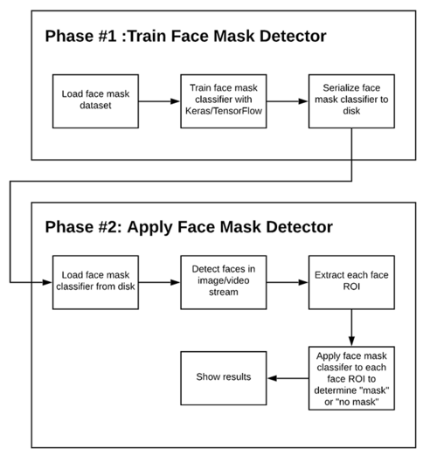
System design:

Slide 9
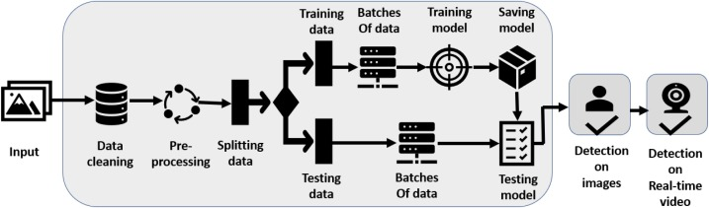
Architecture Diagram

Slide 10
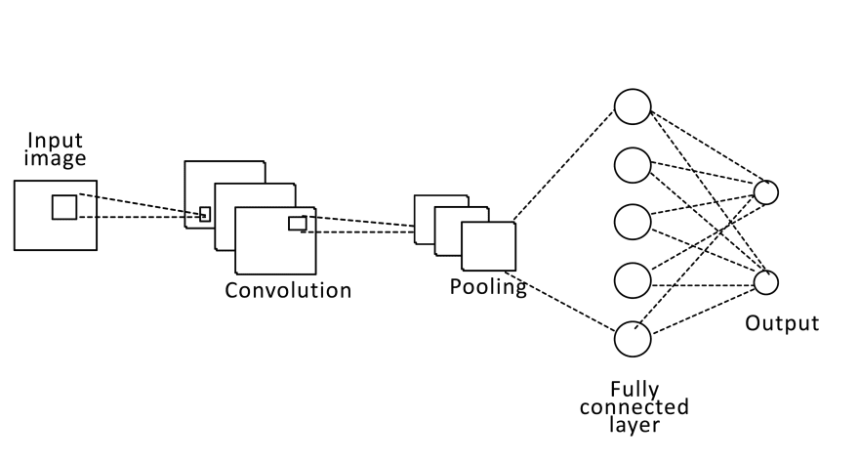
Training model diagram:

Slide 11
Test cases
Face detection-Mark a shape around the detected face-Pass
Multiple face detection-Mark a shape around the detected face-Pass
Identify the plain mask-Display the mask found for any color of the mask-Pass
Identify the pattern mask-Display the mask found for any pattern of the mask-Pass
Identify the mask while wearing sunglasses-Display the mask found for any color of the mask-Pass
Identify the mask of a person having beard-Display the mask found for any color of the mask-Pass

Slide 12
Hardware Requirements
Processor : 2.5 gigahertz (GHz) frequency or above.
RAM : A minimum of 4 GB of RAM.
Hard disk : A minimum of 20 GB of available space.
Monitor : Minimum Resolution 1024 X 768.
Software Requirements
Operating System : Windows 7 and above.
Programming language : Python 2.7 and above.
Platform : IDLE 3.8 and Anaconda prompt.
Supporting libraries : Tensorflow, sklearn, numpy, imutils, and
matplotlib etc.

Slide 13
Thank you.

